Slide 1

Karan kalyana-Power BI Project Presentation
Amazon Prime Analysis & Sales Dashboard.
Presentation by [Karan kalyana] on [24.03.2025].

Slide 2
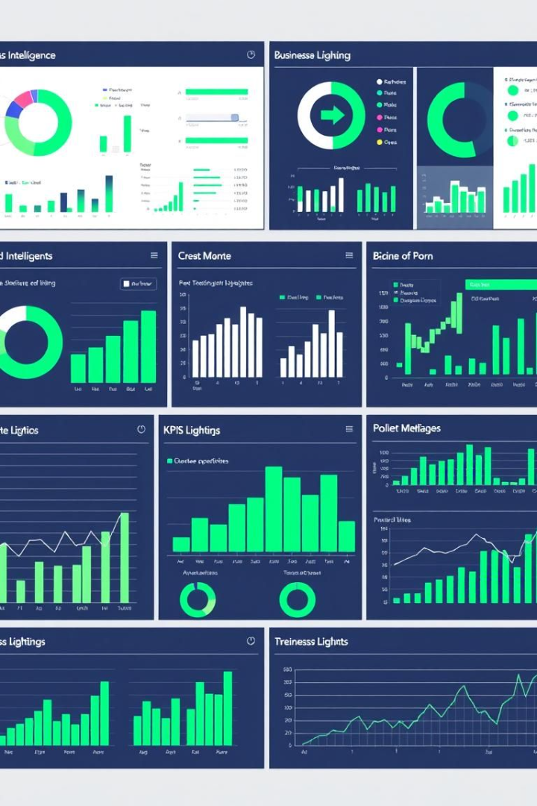
Introduction
Project Overview
Objective
Amazon Prime Data Analysis and Sales Dashboard.
Analyze data, derive insights, and present findings using Power BI.
Agenda
Review objectives, datasets, dashboards, and future scope.

Slide 3
Data Overview
Amazon Prime Data
Sales Dashboard Data
Preparation
Content type, genre, ratings
Sales trends and revenue data
Data cleaning and transformation
Release year analysis
Region-wise performance
Ensuring data quality

Slide 4
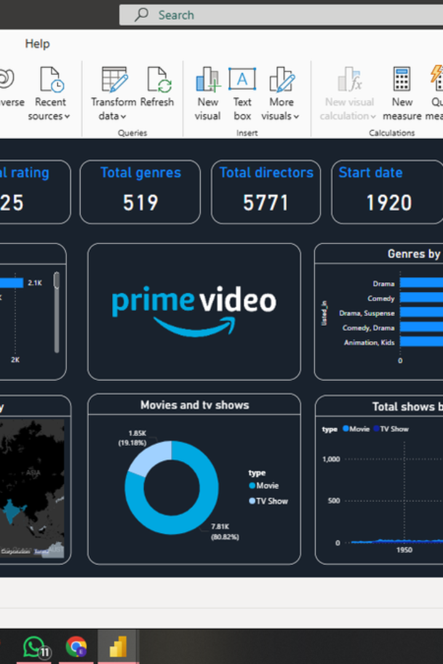






Key Metrics & KPIs
Prime Video
Sales
Movies vs. TV Shows
Genre Popularity
Total Revenue
Top-Selling Products

Slide 5
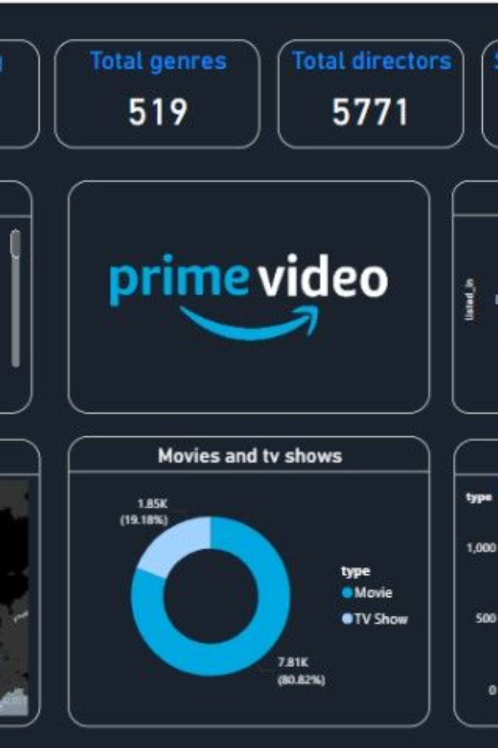
Amazon Prime Dashboard
Genre Trends
Content Trends
Popular genre distribution
Analysis of content over time
Rating Insights
Audience reception metrics

Slide 6
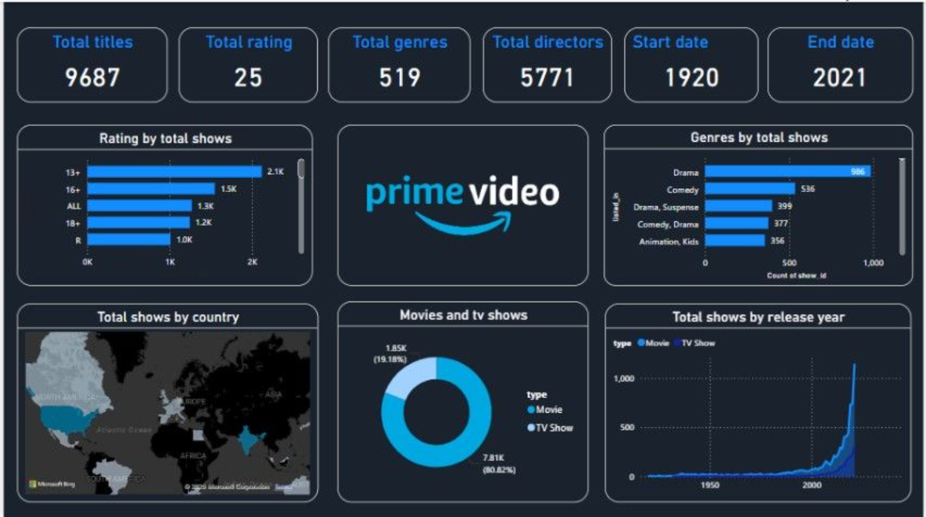

Slide 7
Sales Dashboard
Product Performance
1
Top-selling items
Regional Analysis
2
Sales by geography
Revenue Trends
3
Monthly revenue growth

Slide 8
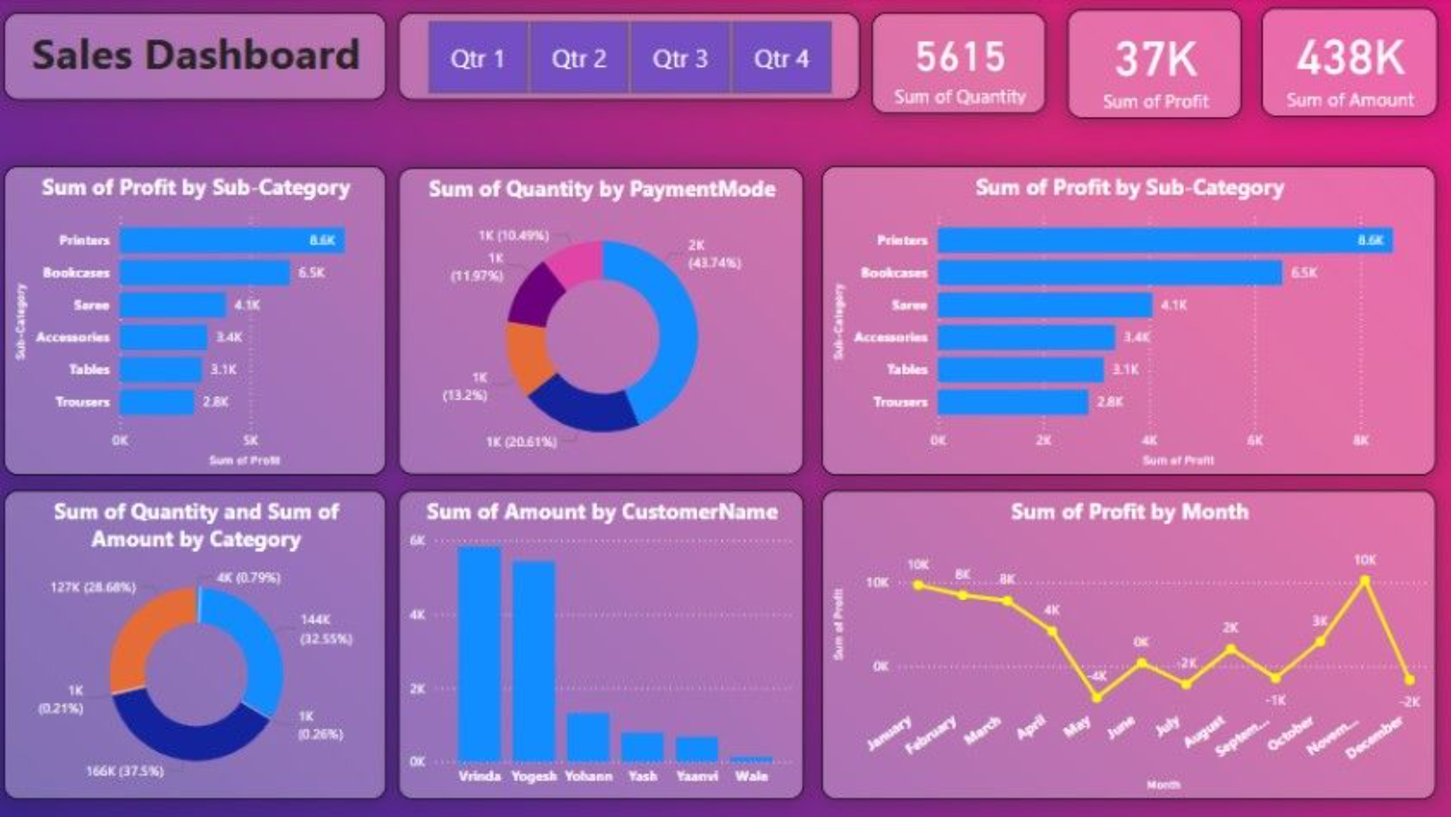

Slide 9

Insights & Findings
1
Genre Preferences
Identify popular genres.
2
Content Trends
Recognize content patterns.
3
Regional Sales
Understand geographic sales trends.
4
Product Performance
Identify high-performing products.

Slide 10

Thank you

